Slide 1
Enhancing parent involvement in NC-ccss for k-2 Mathematics at p.w. moore elementary school

Slide 2
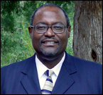
Mentor
Dr. Darnell Johnson
Endowed Professor

Slide 3




Team Members
Jessica Hathaway
William F. Kahan
Rashida Williams
Alicia Reynolds

Slide 4
Abstract
In this study, the 2015 Research Experience Undergraduates (REU) mathematics team from Elizabeth City State University (ECSU) extended the research initiated by the 2014 summer REU mathematics team. A workshop was provided to assist parents to a better understanding of student homework assignments on the North Carolina Common Core State Standards for K-2 Mathematics. Parent involvement is defined as parent participation in the educational processes and experiences of their children. A chi-square analysis was used to analyze data collected from a pre-survey and post survey administered to participants in the workshop. The study revealed all of the individual components of parent involvement were positively and significantly related to educational goals. The study identified aspects of parent involvement that yielded statistically significant results in affirming that parent involvement attributed positively to urban student achievement. These findings were particularly helpful for indicating which kinds of parent involvement influenced academic success. Remarkably, parent expectations and styles demonstrated a strong relationship with scholastic outcomes. Parent expectations and styles created an educationally oriented ambience that established an understanding of certain level of support the child needed to succeed academically. The REU mathematics team focused on three essential questions in this study: (1) What practices will increase parent awareness of K-2 NC-CCSS for mathematics at P. W. Moore Elementary School? (2) What methods can be used to strengthen parent skills in assisting with mathematics homework assignments at P. W. Moore Elementary School? (3) What actions can be taken to motivate parent involvement in the school improvement process focusing on mathematics at P. W. Moore Elementary School?

Slide 5
Overview
Purpose
Methodology
Parent Workshop Flyer
Focus Questions
Pre and Post Survey
Chi Square Test
Chi Square Data Tables
Chi Square Data Charts
Math Team Workshop
Conclusion
Questions

Slide 6
Purpose
The purpose of this research was to develop training sessions in mathematics support skills for parents and/or guardians of K-2 grade students enrolled at P. W. Moore Elementary School. Parents’ attitudes toward mathematics have an impact on children's’ attitudes. This process will extend mathematical concepts from the classroom to home and establish the idea that mathematics is not just a school subject, but also an everyday subject.

Slide 7
Methodology
Mathematics Team members in the REU program at ECSU worked to build a data collection system specifically for this research. This collection system provided an assessment of K-2 grade parents and their current knowledge pertaining to the North Carolina Common Core State Standards. In preparation for the research workshop, the mathematics team went to P. W. Moore Elementary School to observe the interactions between teachers and students in Kindergarten, 1st grade, and 2nd grade. Information was collected concerning the benefits of parent involvement and its relation between the Common Core State Standards for K- 2 grade mathematics. Once a survey was constructed, the three focal points were presented by the mathematics team at a workshop; formatted to supply the parents with some of the information and activities needed to assist their child at home.
On the day of the workshop, the mathematics team arrived early at P.W. Moore Elementary School to organize each member’s designated grade level area. After parents arrived, a brief introduction was given stating the purpose and goal of the workshop. The parents were split into three different workshops pertaining to their child’s grade level. A pre-survey was completed at the beginning of the workshop and a video was viewed that explained the importance of the Common Core State Standards and the key attribute that all children despite background are given the same advantages to an education. Using the mathematics activities in relation to each grade level respective Common Core State Standards, parents constructed miniature activities to introduce to their children in the home environment [9].

Slide 8
Methodology cont.
Throughout the activities, parents were encouraged to use mathematics language in their homes allowing their child to become accustomed to using different learning styles. The parents were also informed of the benefits as they continue to become more involved in their children’s education. At the conclusion of the workshop a post-survey was administered to determine if their perspective on assistance with mathematics changed in comparison to their pre-survey. To conclude the workshop, parents were given participation awards and parent helper kits to continue in their efforts of being involved in their child’s education.
The survey instrument consisted of three focus sections. In these twenty-five questions, participants were asked to select their level of agreement with each of the statements for their knowledge of North Carolina Common Core State Mathematics Standards for their children and their level of satisfaction with their with 1 = strongly disagree, 2 = disagree, 3 = neutral, 4 = agree, and 5 = strongly agree.

Slide 9
Focus Questions
What practices will increase parent awareness of K-2 NC-CCSS for mathematics at P. W. Moore Elementary School?
What methods can be used to strengthen parent skills in assisting with mathematics homework assignments at P. W. Moore Elementary School?
What actions can be taken to motivate parent involvement in the school improvement process focusing on mathematics at P. W. Moore Elementary School?

Slide 10
Parent Workshop Flyer

Slide 11
Pre and Post Survey

Slide 12
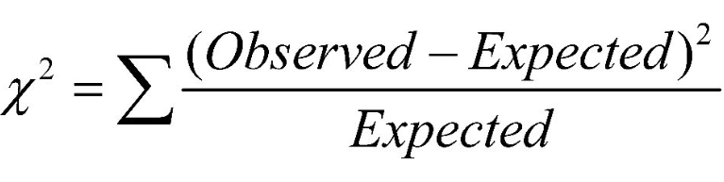
Chi Squared Test
The Chi-Square Test showed a comparison of the observed values (parents’ survey response) and the expected values (parents’ strong agreement), which are listed above and concluded that the impact of the Parent Involvement Workshop was considered to be a positive factor in influencing parents’ attitudes toward the research focus questions. In the analysis of the pre and post surveys, the Chi-Square Test determined a statically significant relationship exists.

Slide 13
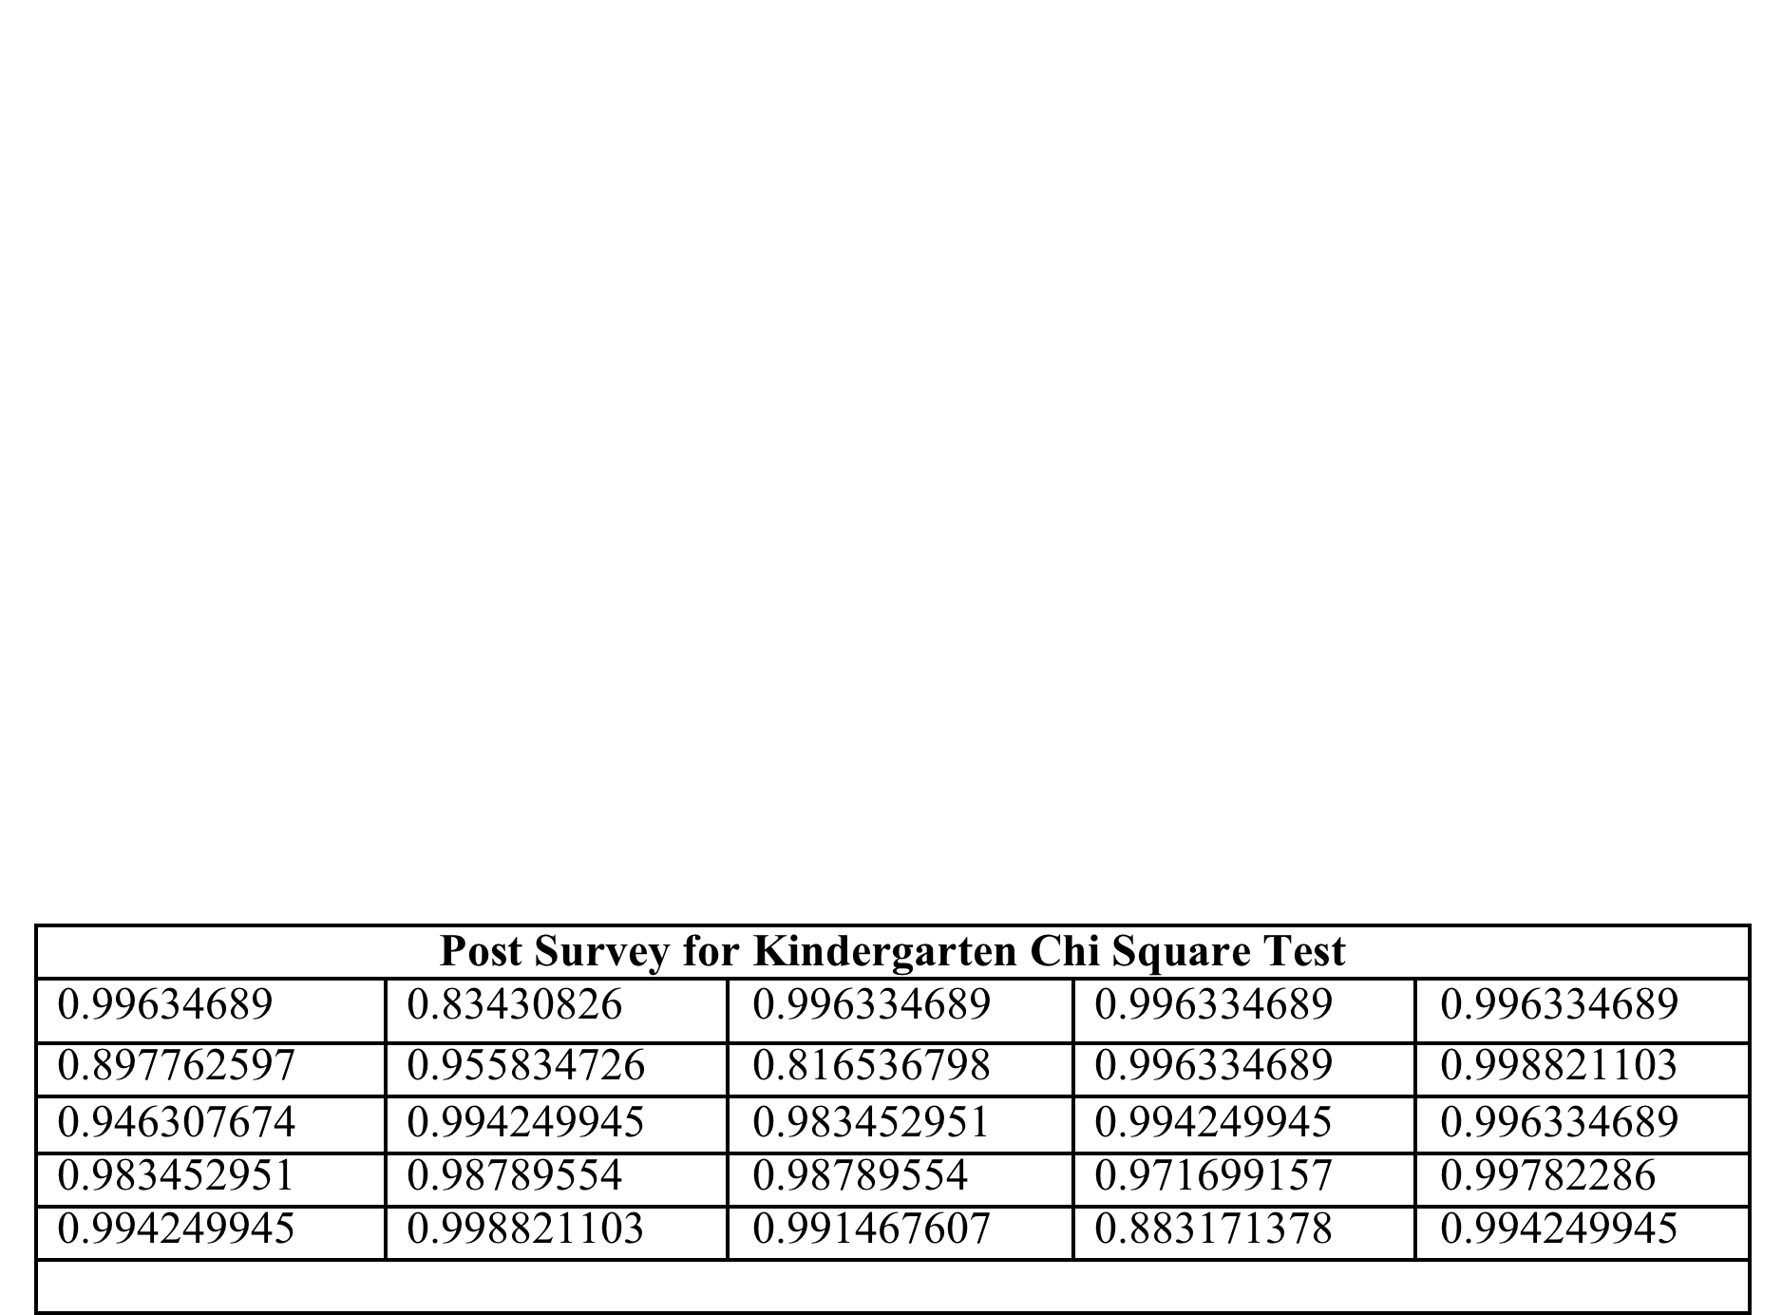
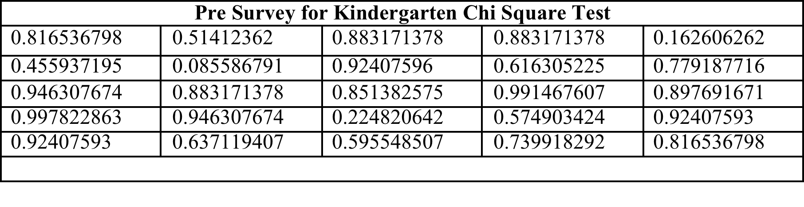
Chi-Square Data Tables

Slide 14
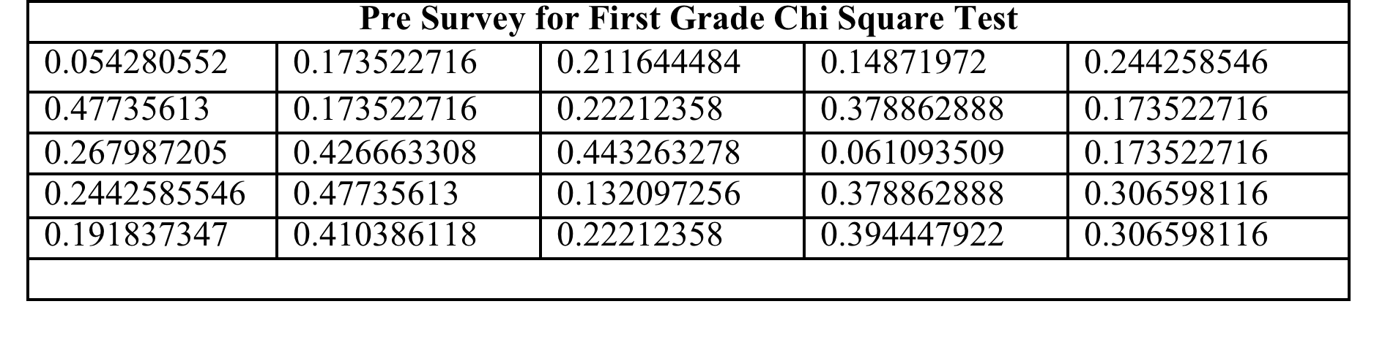
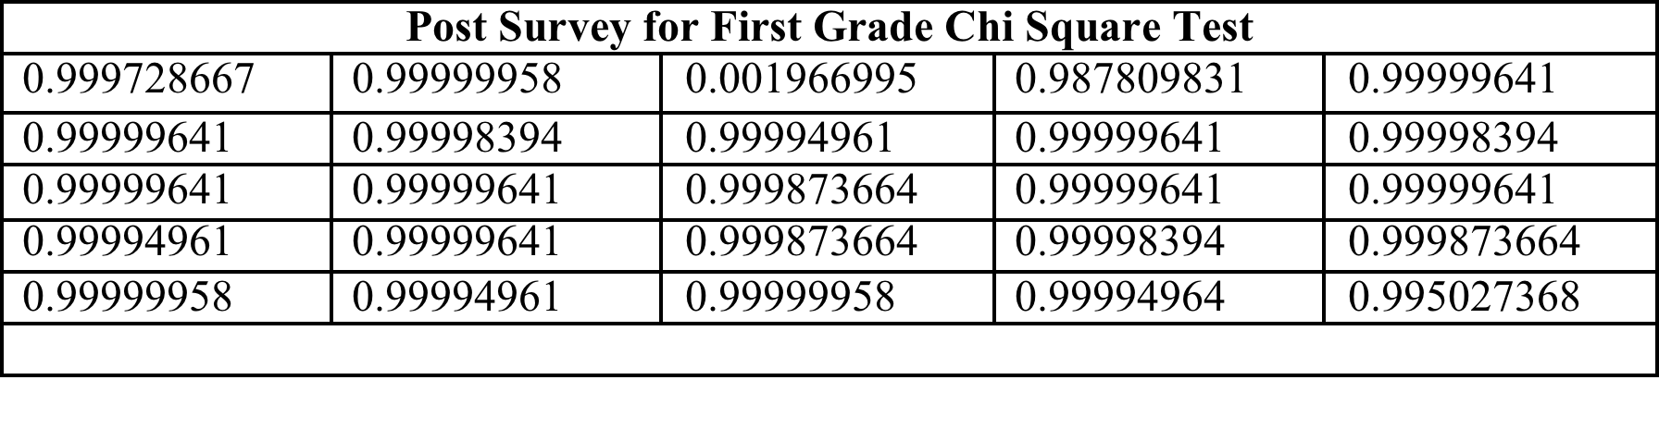
Chi-Square Test Data Tables

Slide 15
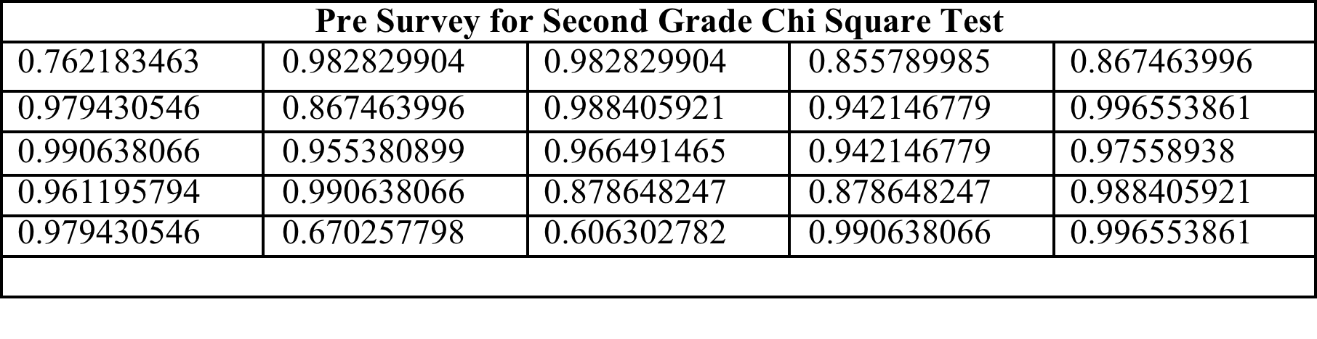
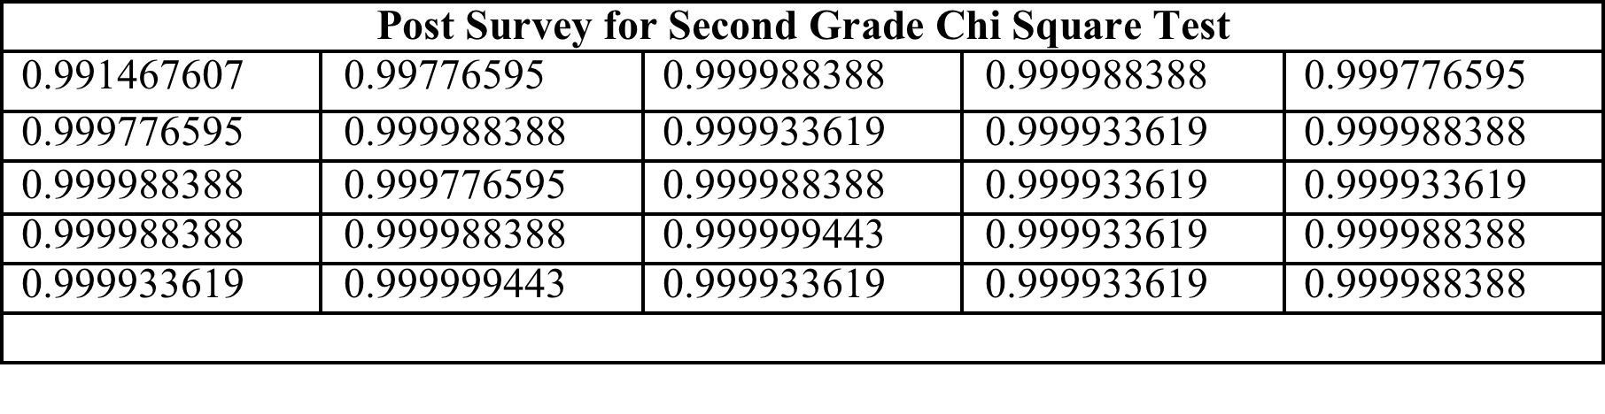
Chi-Square Test Data Tables

Slide 16
Chi-Square Test Chart

Slide 17
Chi-Square Test Chart

Slide 18
Chi-Square Test Chart

Slide 19
Chi-Square Test Chart

Slide 20
Chi-Square Test Chart

Slide 21
Chi-Square Test Chart

Slide 22
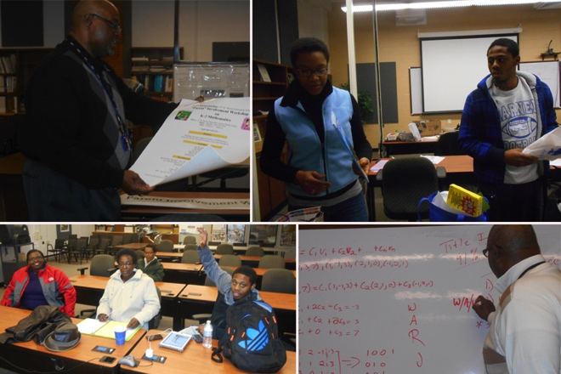
Math Team Discussion of Research

Slide 23
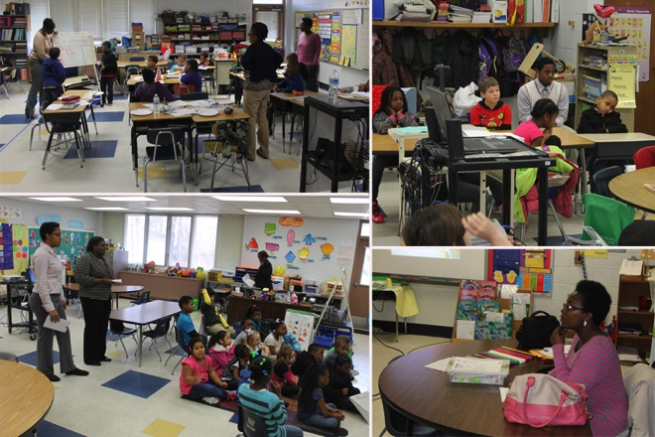
Math Team Observes Math Classes at P.W. Moore Elementary School

Slide 24
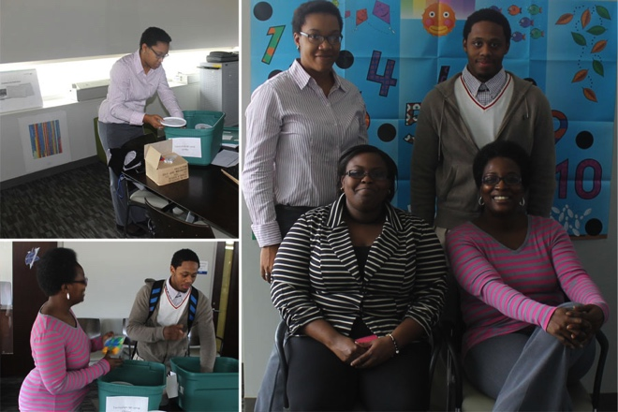
Math Team Plan for Parent Workshop

Slide 25
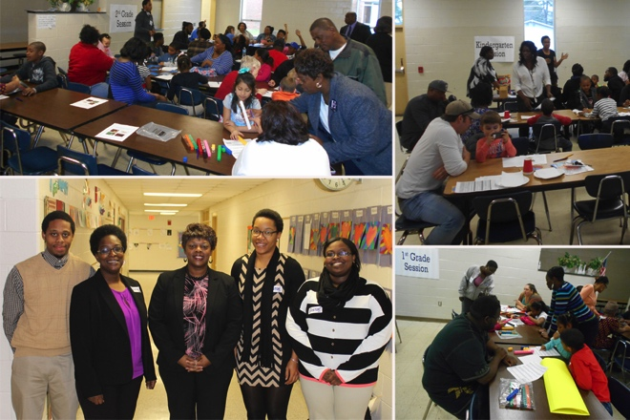
Math Team Coordinating Parent Workshop

Slide 26
Conclusion
The results of the surveys concluded that Parent Involvement contributes to growth in student learning. Involved parents accomplish things, including motivating and engaging their children, acquiring new knowledge and skills, and collaborating with teachers. But those accomplishments best serve their purpose when they lead their children to help improve student achievement. The workshop provided richer information on what skills and topics students are learning according to the North Carolina Common Core State Standards. Assisting parents in an understanding of the standards provided the parents with a different perspective on mathematics and the importance of being involved with their child’s education. Parents understood the math language by constructing different activities during the workshops and were given different tips that can be used in the home. Take-home activities and tips given in the parent tool kits benefited parents in assisting with student homework and learning. Most education reformers agree that improving student learning defines effective teaching [10].

Slide 27
Future Work
The long-term goal is to build a stronger parent support system in Kindergarten, 1st grade, and 2nd grade Mathematics in Pasquotank County Public Schools using the North Carolina Common Core State Standards. It is our intent to continue working with Title I elementary schools in the Pasquotank County Public School System. The mathematics team will provide an increased number of workshops during the school year to strengthen parent attendance and student achievement of K-2 mathematics.

Slide 28
Acknowledgements
The members of the 2015 Research Undergraduates Mathematics Team would like to give a special thanks to Dr. Linda B. Hayden, Dr. Darnell Johnson, Principal Lindsey James, 2014 Teacher of the Year Mrs. Joycelyn Hinton, the REU staff, and faculty of P.W. Moore Elementary School for guidance and assistance during this research process.

Slide 29
Questions?

